Slide 1

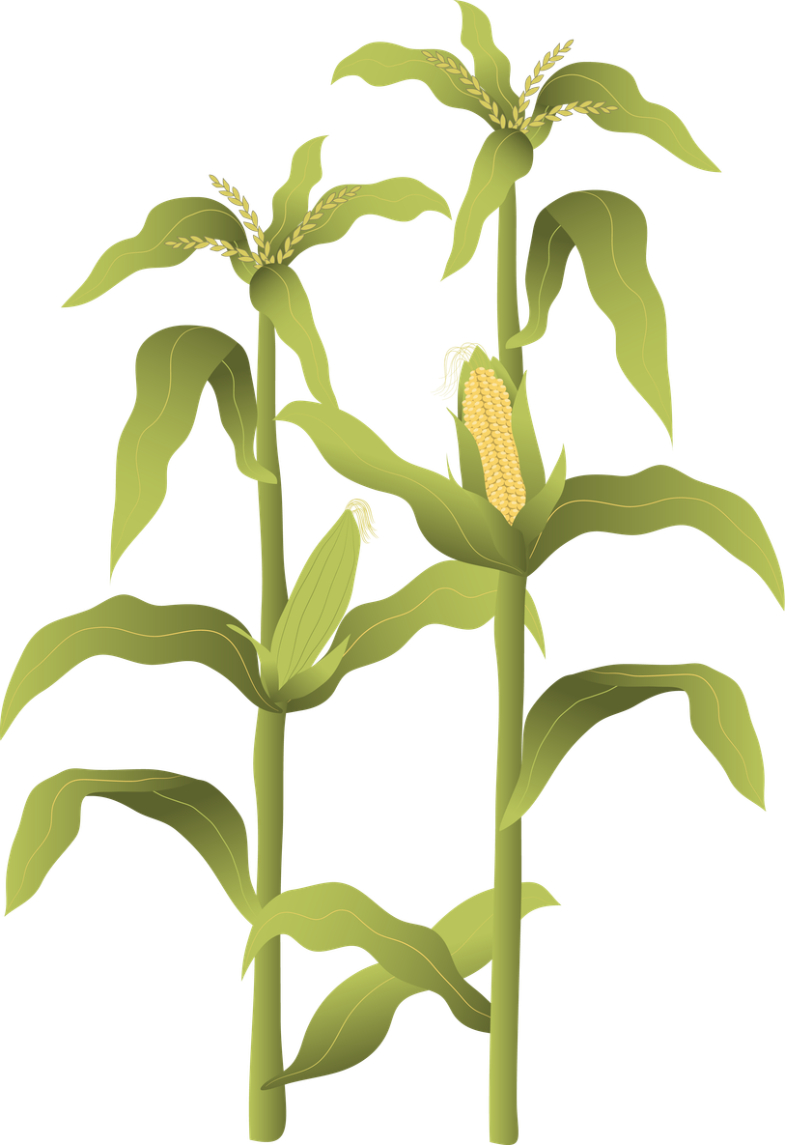
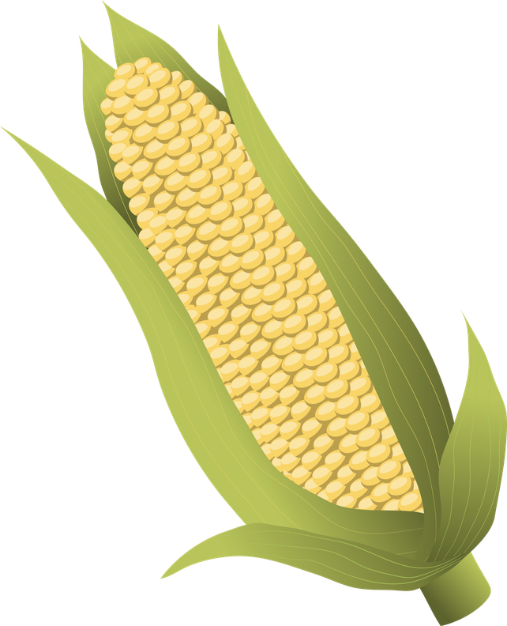
PROJECT BASED ON
DATA STRUCTURES AND ALGORITHM
PREDICTIVE
FARMING
FOR BETTER YIELDS
M.KEERTHI SRI
2520030079
SEC : 04

Slide 2
ABSTRACT:
The Predictive Farming System is designed to help farmers select suitable crops based on environmental conditions such as temperature, rainfall, and soil pH. The system stores crop information including the required temperature range, rainfall range, and soil pH values for different crops.
Using Data Structures and Algorithms (DSA) concepts, the program organizes crop data in an array and applies searching techniques to identify crops that match the given environmental conditions. The system also uses a sorting algorithm (Bubble Sort) to arrange crops based on their rainfall requirements for better analysis.
The user enters environmental parameters, and the system predicts and displays the crops that can grow effectively under those conditions. This project demonstrates how DSA concepts like arrays, searching, and sorting can be applied to create a simple decision-support system for agriculture.
Overall, the Predictive Farming system provides a basic smart farming solution that helps in selecting suitable crops, improving agricultural planning, and promoting better crop yield.

Slide 3
EXISTING SYSTEM:
In the existing system, farmers usually decide which crop to grow based on traditional knowledge, past experience, and general weather conditions. These decisions are often made manually without using any structured data analysis or computational methods.
Farmers may rely on local advice, seasonal patterns, or trial-and-error methods to select crops suitable for their land. However, this approach may not always consider important factors such as exact temperature range, rainfall levels, and soil pH, which are crucial for crop growth.
Due to the lack of a systematic method, the existing system can lead to incorrect crop selection, lower productivity, and inefficient use of resources. It also does not provide any automated way to analyze environmental conditions or suggest the most suitable crops for better yield.

Slide 4
PROPOSED SYSTEM:
The proposed system is a Predictive Farming System that helps farmers identify suitable crops based on environmental conditions such as temperature, rainfall, and soil pH. The system stores crop details and their required growing conditions using a data structure(array).
Using searching techniques, the program compares the user-entered environmental values with the stored crop requirements and predicts the crops that can grow effectively under those conditions. It also applies a sorting algorithm to arrange crops based on rainfall requirements for better analysis.
The system provides a simple and automated decision-support tool that helps farmers choose the right crop for their land. This reduces guesswork and improves agricultural planning, which can ultimately lead to better crop yield and efficient use of resources.

Slide 5
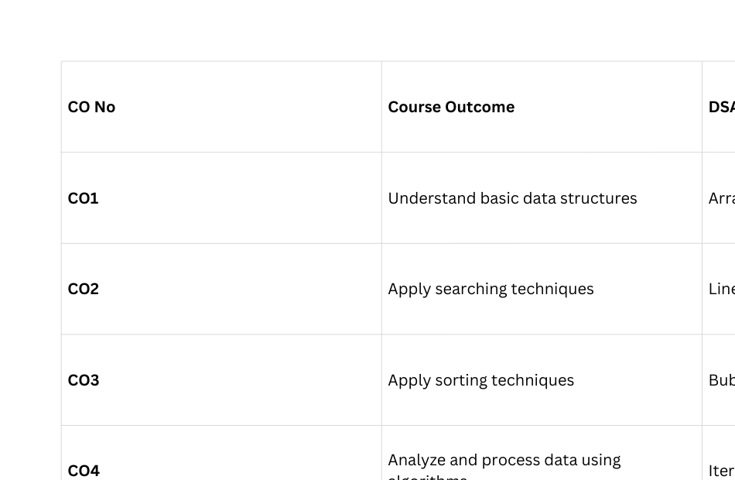
CO ATTAINMENTS:

Slide 6
OBJECTIVES:
To develop a predictive farming system that helps farmers choose suitable crops based on environmental conditions.
To store crop information efficiently using appropriate data structures such as arrays.
To apply searching algorithms to identify crops that match the given temperature, rainfall, and soil pH conditions.
To use sorting algorithms to organize crops based on rainfall requirements for better analysis.
To reduce manual decision-making by providing an automated method for crop selection.
To demonstrate the practical application of Data Structures and Algorithms (DSA) in solving real-world agricultural problems

Slide 7
CONCLUSION:
The Predictive Farming System demonstrates how Data Structures and Algorithms (DSA) can be applied to solve real-world agricultural problems. The program stores crop information using arrays and applies searching and sorting algorithms to analyze environmental conditions such as temperature, rainfall, and soil pH.
Based on the given inputs, the system predicts suitable crops that can grow effectively under those conditions. This helps in making better farming decisions and improves crop planning. The sorting feature also organizes crops based on rainfall requirements for easier analysis.
Overall, this project shows that using DSA concepts like arrays, searching, and sorting can help create a simple and efficient system for predicting suitable crops and supporting better agricultural productivity.

Slide 8
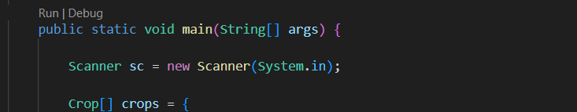
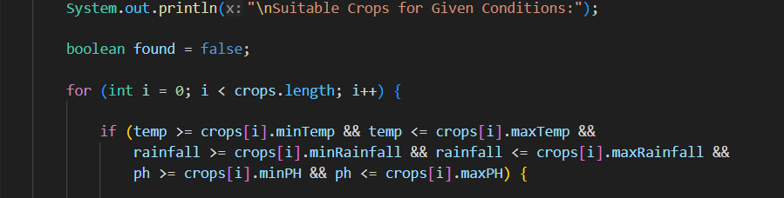
CO-1:
CO-2:

Slide 9
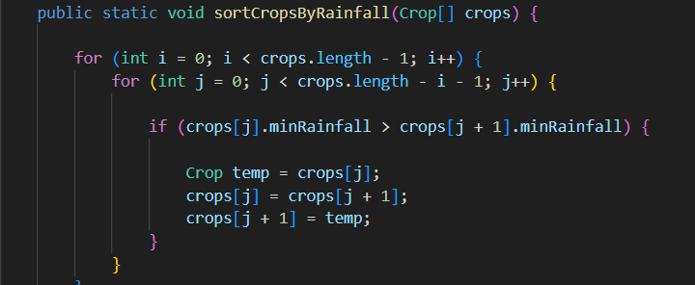
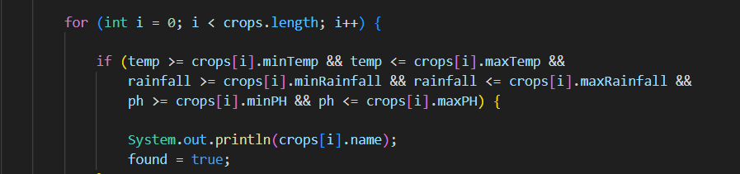
CO-3:
CO-4:

Slide 10
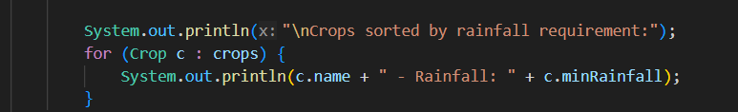
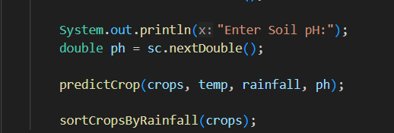
CO-5:
CO-4:

Slide 11
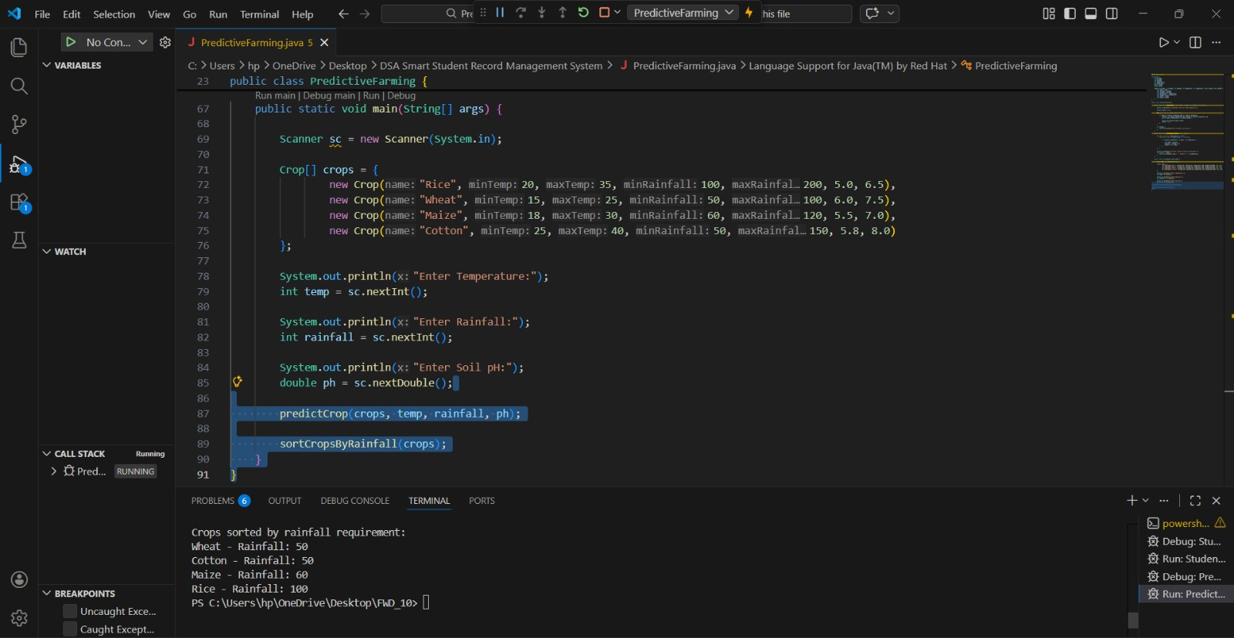
CODE SCREENSHOTS:

Slide 12

Liceria & Co.
THANK YOU!
We appreciate your time! Organic farming is a sustainable way to nourish the planet.

